Slide 1
Abstractive Text Summarization

Slide 2
-LRB- CNN -RRB- -- Fifteen people have now died after consuming cantaloupe contaminated with the listeria monocytogenes bacteria , the Centers for Disease Control and Prevention said Friday . At least 84 people in 19 states have become ill with the bacteria , the agency said . And the number of illnesses could still grow , added the CDC , citing reporting lags and how the disease can develop slowly in some people . On Tuesday , the CDC was reporting 13 deaths and 72 illnesses in what was already then the deadliest food-borne illness outbreak in the United States since 1998 . Five people have died in New Mexico from eating the tainted cantaloupes , the CDC said .Most of those who fell ill are more than 60 years old , the CDC said . Doctors also are closely monitoring the pregnancies of two women who ate contaminated cantaloupe , with the agency noting that listeriosis can cause miscarriages and stillbirths . Older adults and people with compromised immune systems are also especially susceptible . Public health investigators have traced the source of the bacteria to a farm in Granada , Colorado . Food Poisoning 101. The grower , Jensen Farms , issued a recall for its Rocky Ford-brand cantaloupes on September 14 . By now , the cantaloupes should all be off store shelves , the CDC said . The agency warned that people should not eat Rocky Ford cantaloupes , even if they have eaten part of one and have not yet fallen ill . It also said that consumers should be wary of eating any cantaloupes if they do n't know where they came from .How to keep your food safe
Create a coherent and fluent summary having only the main points outlined in the document
15 people have now died after consuming cantaloupe contaminated with listeria monocytogenes bacteria. At least 84 people in 19 states have become ill with the bacteria, the CDC says. The source of the bacteria has been traced to a farm in Granada, Colorado. Jensen Farms issued a recall for its Rocky Ford-brand cantaloupes on September 14.
TEXT SUMMARIZER
Type of Summarization
Extractive Summarization
Picks up sentences( informative and important fragments) directly from the document based on a scoring function to form a coherent summary.
Abstractive Summarization
Producing summary by interpreting the text — parts of which may not appear as part of the original document.
Conveys the most critical information from the original text, requiring rephrasing sentences and incorporating information from full text to generate summaries such as a human-written abstract.

Slide 3
Benefits
Reducing reading time
Accelerates the process of researching for information
Increases the amount of information that can fit in an area
Can improve performance of
  Text Classification
  Question answering
  Common Application Areas
  Legal text summarization
  News summarization and headline generation
  Patient History Summarization

Slide 4
Evaluating summaries
ROUGE-N: Overlap of n-grams between the system and reference summaries.
  ROUGE-1 refers to the overlap of unigram (each word) between the system and reference summaries.
  ROUGE-2 refers to the overlap of bigrams between the system and reference summaries.
ROUGE-L: Longest Common Subsequence (LCS) based statistics. Longest common subsequence problem takes into account sentence level structure similarity naturally and identifies longest co-occurring in sequence n-grams automatically.
ROUGE-W: Weighted LCS-based statistics that favors consecutive LCSes .
ROUGE-S: Skip-bigram based co-occurrence statistics. Skip-bigram is any pair of words in their sentence order.
ROUGE-SU: Skip-bigram plus unigram-based co-occurrence statistics.

Slide 5
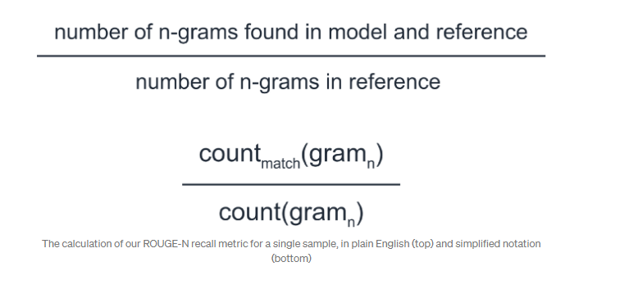
How good is Rouge Score?

Slide 6
Abstractive Summarzation
Does not select sentences from the originally given text passage to create the summary
They produce a paraphrasing of the main contents of the given text - using a vocabulary set possibly different from the original document
Creates a semantic representation of the long document – generates another shorter representation that is semantically equivalent to the earlier one
Involves - Natural Language Generation

Slide 7
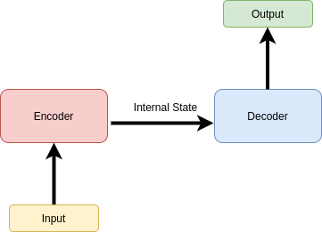
Is summarization same as translation?
Both are sequence to sequence problems
Translation has to be loss-less – Summarization is lossy
Length of summary does not depend on the original text

Slide 8
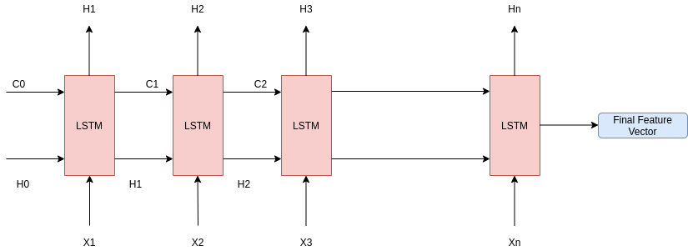
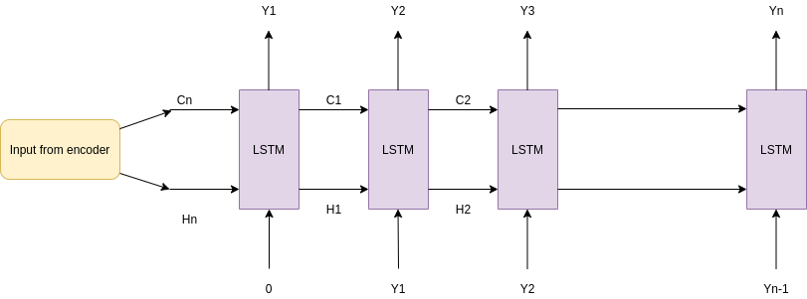
Encoder - Decoder architecture using RNNs
The encoder-decoder model is trained on a target set or vocabulary of words
Now, in each step, of the decoder, the LSTMs hidden activation is sent through a softmax layer which generates the probabilities for each word in the vocabulary to be predicted as the next word.
The word with the maximum probability is chosen as the output at that time step.
To know which word exactly suits the semantics - the model trains on a dataset and solves the problem as a supervised classification problem.

Slide 9
Issue with LSTM based Encoder-Decoder
If the original document is very large – the focus of the model is more on the words towards the end, not what is in the beginning
Humans on the other hand usually summarize from 1–5 lines
  Moves forward slowly
  Rarely goes up to consider the 100th line
This aspect could not be implemented by the normal encoder-decoder model

Slide 10
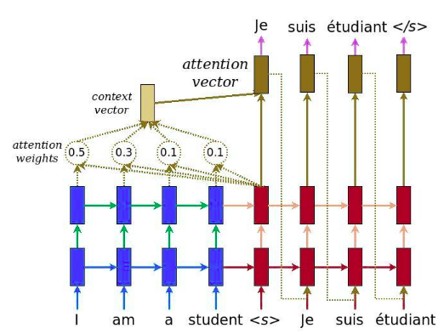
Attention Mechanism
Attention layer by TensorFlow
For predicting a word - each word in the input sequence is being assigned a weight, called the attention weights
The summation of the vectorized attention weights is used to form the context vectors which are used for prediction
Nallapati et al. - Abstractive Text Summarization using Sequence-to-sequence RNNs and Beyond; https://arxiv.org/pdf/1602.06023.pdf

Slide 11
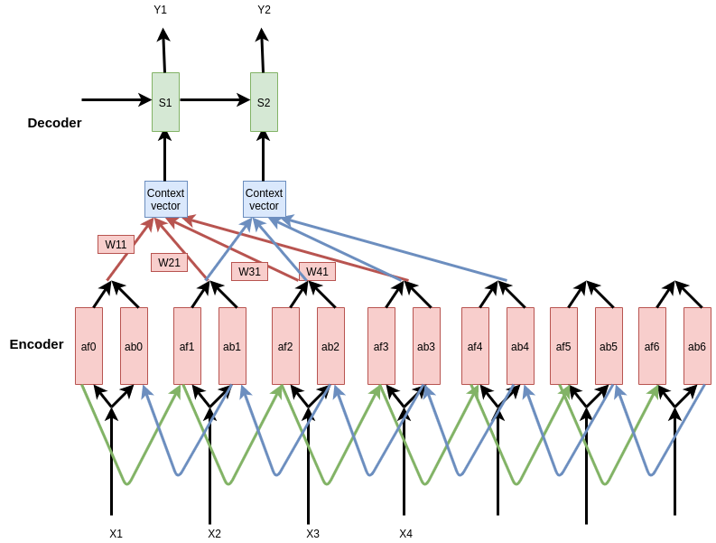
W<m,n>= softmax(e<m,n>) for all m
Context vector is the weighted sum of the attention weights
C< n >= Sum(W<m,n>.a<m>) for all m in the input time steps.
unidirectional GRU RNN
bi-directional GRU RNN

Slide 12
Large Vocabulary Trick
The words predicted by the decoder are generated using a softmax
Since a vocabulary is large - the softmax will have a huge number of output nodes, and the prediction will be computationally inefficient
Trick
  The model is trained in mini-batches
  The target word set or the decoder-vocabulary of each minibatch is restricted to the source document of that particular mini-batch plus the frequently occurring words in the vocabulary
Decreases the resource requirements

Slide 13
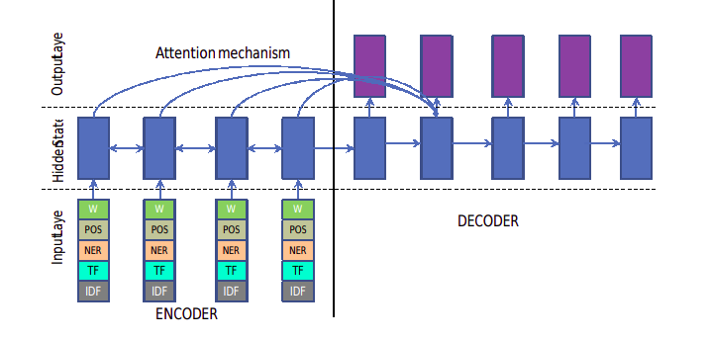
Additional information – adding context to word

Slide 14
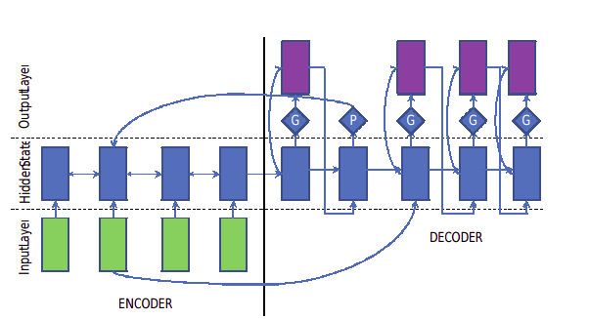
Switching Generator-Pointer
In any supervised model - often there is a need to handle some words during application - that were not present in vocabulary
Handling out-of-vocabulary words - In normal cases, these are termed ‘UNK’ tags
But in the case of summarizations – these terms may be the key / significant terms
Switching decoder pointer is introduced - At each time step of the decoder, there is a pointer maintained to the input text. Whenever the decoder faces an OOV term, it points to a term in the input and uses the term from the input text directly
So, the decoder has two actions at a time step - it can generate a word from the target dictionary or it can point and copy a word
This decision is taken using a switch If the switch is turned on it generates a word else it copies a word from the input.

Slide 15
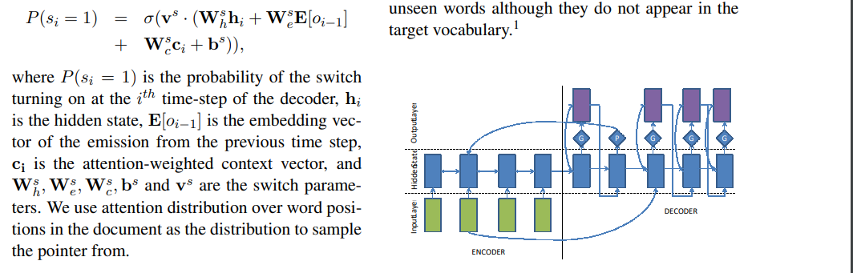
Designing the Switch
The switch is a sigmoid activation function over the entire context vector at a particular decoder time step
W, v – model parameters
H – hidden state
O – output of previous state
What is learnt – whether to generate or point to copy (G / P)
From which position to copy

Slide 16
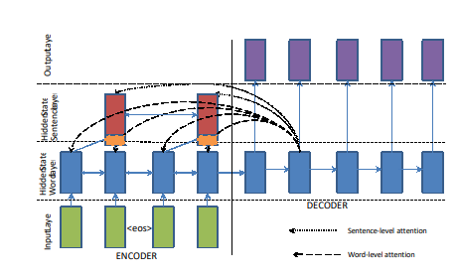
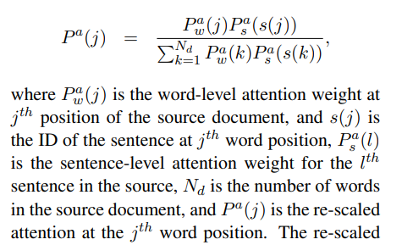
Handling long documents – hierarchical LSTMs
Two bi-directional RNNs at source –
The attention mechanism operates at both levels simultaneously.

Slide 17
References
IBM’s approach: https://arxiv.org/abs/1602.06023
Google’s approach: https://arxiv.org/abs/1704.04368
Facebook’s approach: https://arxiv.org/abs/1509.00685

Slide 18
Transformer based Models
BART ^{[1]}
  BART: Denoising Sequence-to-Sequence Pre-training for Natural Language Generation, Translation, and Comprehension – 2019
  Trained by corrupting text with an arbitrary noising function and learning a model to reconstruct the original text
PEGASUS ^{[2]}
  PEGASUS: pre-training with extracted Gap-sentences for Abstractive summarization – 2020
  Propose a pre-training large transformer-based encoder-decoder models on massive text corpora with a new self-supervised objective - important sentences are removed/masked from an input document and are generated as one output sequence .
ProphetNet ^{[3]}
  Prophetnet: predicting future n-gram for sequence to sequence pre-training – 2020
  Instead of optimizing one-step-ahead prediction in the traditional seq-to-seq model - this model optimized by n-step ahead prediction that predicts the next n tokens simultaneously based on previous context tokens at each time step
  Encourage future tokens planning and prevent overfiiting on strong local correlation

Slide 19
Overview
Self-supervised methods – no additional training data
Masked language models - essentially denoising autoencoders that are trained to reconstruct text where a random subset of the words has been masked out
Pretraining has two stages
  (1) text is corrupted with an arbitrary noising function,
  (2) a sequence-to-sequence model is learned to reconstruct the original text.

Slide 20
BART
BART uses the standard sequence-to-sequence Transformer architecture except that it modifies ReLU activation functions by GeLUs
Each layer of the decoder additionally performs cross-attention over
the final hidden layer of the encoder
BART does not use an additional feed-forward network before word prediction

Slide 21
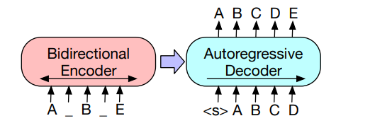
BART Model
Pre-trains a model combining Bidirectional and Auto-Regressive Transformers

Slide 22
Pre-training BART
BART is trained by corrupting documents and then optimizing a reconstruction loss—the cross-entropy between the decoder’s output and the original document
BART allows users to apply any type of document corruption

Slide 23
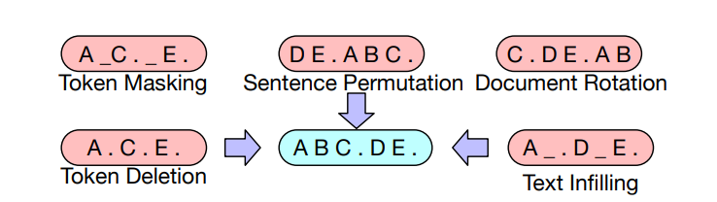
Token Masking random tokens are sampled and replaced with [MASK] elements
Token Deletion Random tokens are deleted from the
Input - the model must decide which positions are missing inputs
Text Infilling A number of text spans are sampled,
with different span lengths - each span is replaced with a single [MASK] token
Text infilling teaches the model to predict how many tokens are
missing from a span.
Sentence Permutation - A document is divided into sentences based on full stops, and these sentences are shuffled in a random order
Document Rotation A token is chosen uniformly at random, and the document is rotated so that it begins with that token.
This task trains the model to identify the start of the document.

Slide 24
Sequence Generation Task
BART autoregressive decoder can be directly fine tuned for sequence generation tasks such as abstractive summarization
Information is copied from the input but manipulated
  which is closely related to the denoising pre-training objective
Here, the encoder input is the input sequence, and the decoder generates outputs autoregressively.

Slide 25
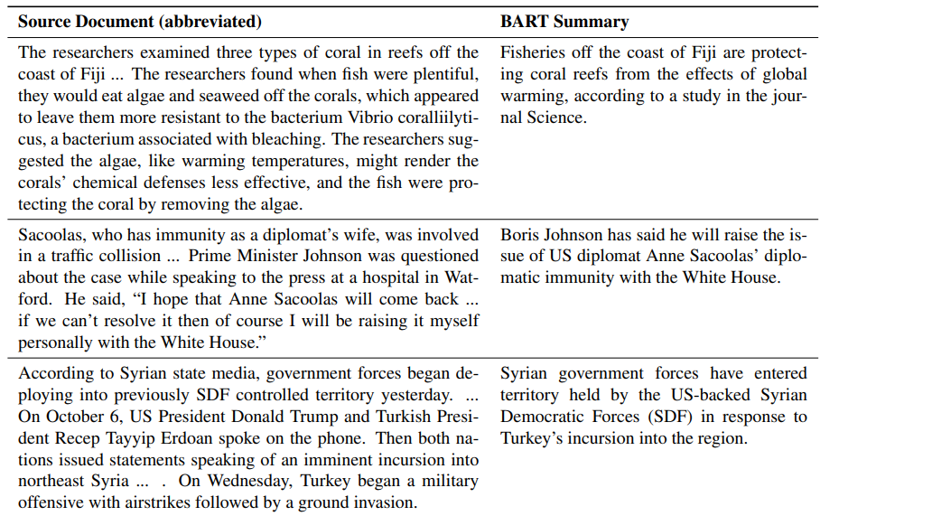

Slide 26
BART was not designed only for summarization
Question – Answering
Machine Translation

Slide 27
PEGASUS
Important sentences are removed/masked from an input document and are generated together as one output sequence from the remaining sentences, similar to an extractive summary.
PEGASUS: Pre-training with Extracted Gap-sentences for Abstractive Summarization :
Proceedings of the 37 th International Conference on Machine Learning, Online, PMLR 119, 2020)

Slide 28
Pretraining objectives were meant for summarization tasks
For abstractive text summarization and evaluate on 12 downstream datasets spanning news
Masking whole sentences from a document and generating these gap-sentences from the rest of the document works well as a pre-training objective for downstream summarization tasks
PEGASUS masks multiple whole sentences rather than smaller continuous text spans
In particular, choosing putatively important sentences outperforms lead or randomly selected ones

Slide 29
Pre-training in Pegasus
Select and mask whole sentences from documents
Concatenate the gap-sentences to represent a pseudo-summary
The corresponding position of each selected gap sentence is replaced by a mask token [MASK1]
  Informs the model
Gap sentences ratio (GSR) refers to the number of selected gap sentences to the total number of sentences in the document
  Similar to mask rate

Slide 30
To approximate a Summary better
Select sentences that appear to be important/principal to the document
Random - Uniformly select m sentences at random
Lead - Select the first m sentences
Principal - Select top-m scored sentences according to importance
  As a proxy for importance - compute ROUGE1- F1 score between the sentence and the rest of the document,
  s_{i} = rouge(x_{i} , D \ {xi}), ∀I
  Sentences are scored independently and the top m selected

Slide 31
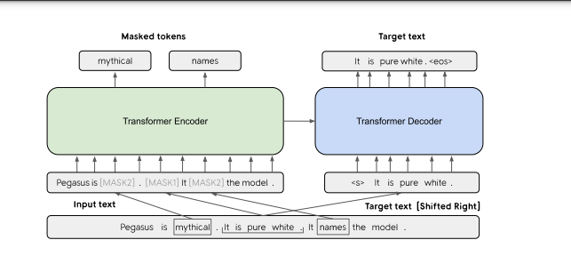
One sentence is masked with [MASK1] and used as target generation text (GSG).
The other two sentences remain in the input, but some tokens are randomly masked by [MASK2] (MLM).

Slide 32
Zero and Low-Resource Summarization
In real-world it is often difficult to collect a large number of supervised examples to train or fine-tune a summarization model
PEGASUS – pretrained + fine-tuned with a few examples
Simulation of low-resource summarization setting
  Pick the first 10^{k} (k = 1, 2, 3, 4) training examples from each dataset to fine-tune PEGASUSLARGE
  Example setting - Up to 2000 steps with batch size 256, learning rate 0.0005, and pick the checkpoint best validation performance

Slide 33
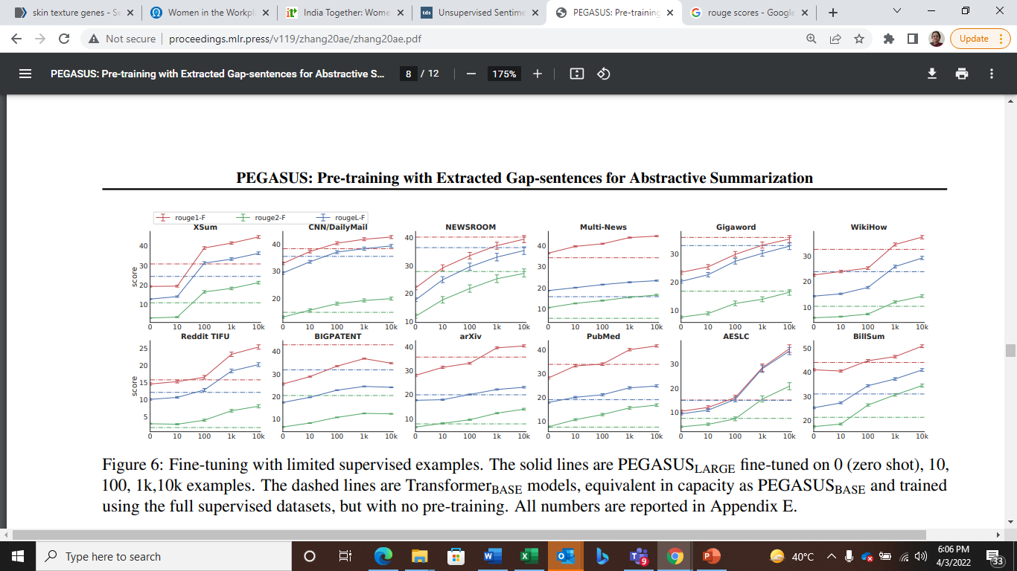

Slide 34
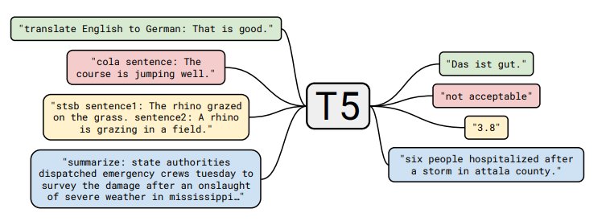
Text-to-text-Transfer-Transformer (T5)
Every text processing problem can be treated as a “text-to-text” transformation problem
1. Machine translation
2. Classification task
3. Regression task - predict similarity of two sentences
4. Document summarization
https://arxiv.org/pdf/1910.10683v3.pdf

Slide 35
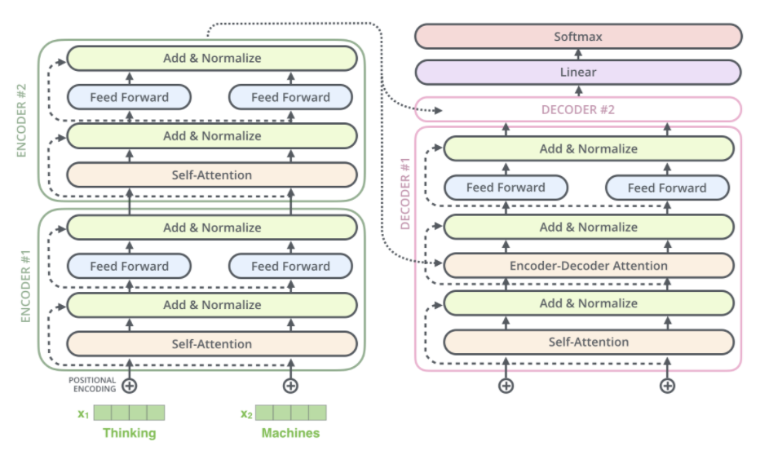

Slide 36
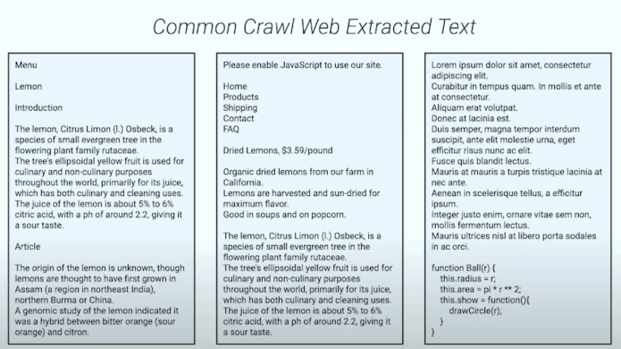
De-duplicated Common Web crawl - cleaned
750 gigabytes of clean-ish English text

Slide 37
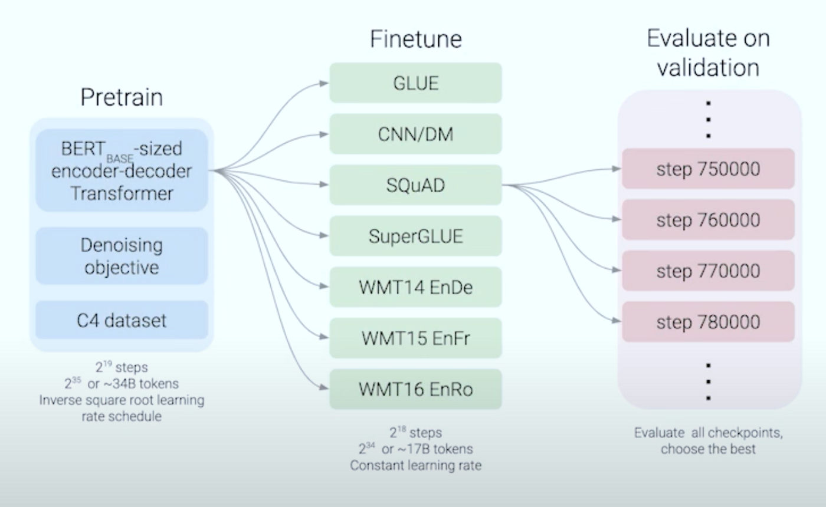
Fine-tuning with Multiple tasks

Slide 38
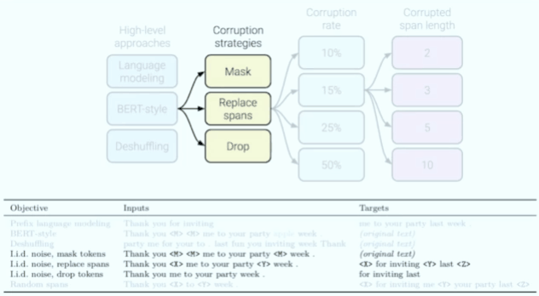
3 strategies tried
Only masking tokens and do not swap tokens
Masking tokens and replacing them with a single sentinel token
Removing tokens.
https://www.youtube.com/watch?v=eKqWC577WlI&list=UUEqgmyWChwvt6MFGGlmUQCQ&index=5

Slide 39
references
[1] Mike Lewis, Yinhan Liu, Naman Goyal, Marjan Ghazvininejad, Abdelrahman Mohamed, Omer Levy, Veselin Stoyanov, and Luke Zettlemoyer. Bart: Denoising sequence-to-sequence pretraining for natural language generation, translation, and comprehension. In Proceedings of the 58th Annual Meeting of the Association for Computational Linguistics, pp. 7871–7880, 2020.
[2] Jingqing Zhang, Yao Zhao, Mohammad Saleh, and Peter Liu. Pegasus: Pre-training with extracted gap-sentences for abstractive summarization. In International Conference on Machine Learning, pp. 11328–11339. PMLR, 2020.
[3] Weizhen Qi, Yu Yan, Yeyun Gong, Dayiheng Liu, Nan Duan, Jiusheng Chen, Ruofei Zhang, and Ming Zhou. Prophetnet: Predicting future n-gram for sequence-to-sequence pre-training. In Proceedings of the 2020 Conference on Empirical Methods in Natural Language Processing: Findings, pp. 2401–2410, 2020.
[4] Armen Aghajanyan, Anchit Gupta, Akshat Shrivastava, Xilun Chen, Luke Zettlemoyer, and Sonal Gupta. 2021. Muppet: Massive multi-task representations with pre-finetuning. arXiv preprint arXiv:2101.11038.
[5] Liang, X.; Wu, L.; Li, J.; Wang, Y.; Meng, Q.; Qin, T.; Chen, W.; Zhang, M.; and Liu, T.-Y. 2021. R-Drop: Regularized Dropout for Neural Networks. ArXiv, abs/2106.14448.

